Slide 1



Pythia Discrete Event Simulation for RTT Waiting List Modelling
Chris Reading-Skilton
Information Specialist
Worcestershire Acute Hospitals NHS Trust

Slide 2
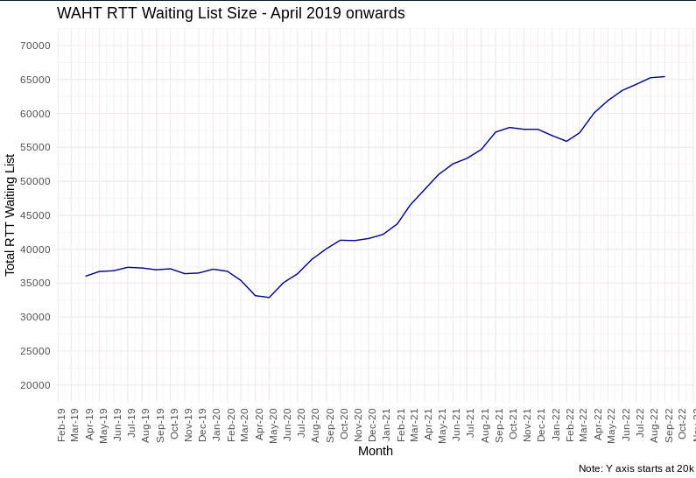
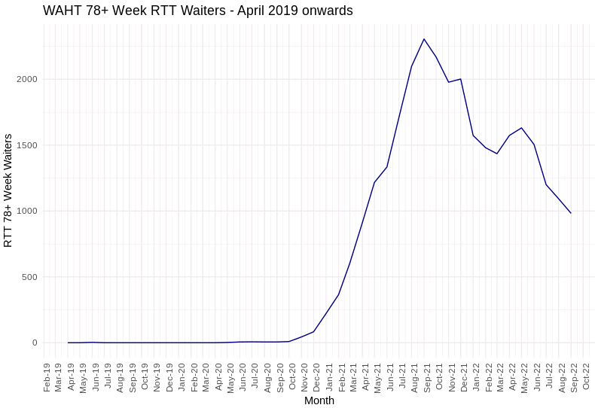
The problem…
18 Week Referral to Treatment Target
Waiting list deterioration since pre-COVID
Modelling interconnected metrics – total waiting list size, 78+/104+ week breaches, performance, clock start and stops
Notes:
18 week referral to treatment target – we have to see 92% of our patients for first definitive treatment within 18 weeks of referral
Even before covid we were not meeting this at WAHT – waiting list has since nearly doubled in size, and long waiters have increased to the point of measuring 104+ week breaches instead of 52+ week breaches (although for now this backlog has been cleared)
Now more than ever it is important for the Trust to be able to predict what our waiting list is going to do – how many long waiters we will have, what proportion will be seen within 18 weeks, and what level of continued waiting list growth may we be looking at

Slide 3


Once upon a time…
Lots of Excel spreadsheets
Fixed point forecasts
Limited to specific metrics
No real understanding of interconnectivity of treatment pathways
Notes:
Pre-COVID, we relied on a system of dozens of excel spreadsheets at specialty level, all answering specific waiting list related questions without really working together to show the knock on effects of proposed changes, and all producing fixed point forecasts without appreciating that random chance in patient pathways can have noticeable impacts on waiting list behaviour

Slide 4

Trying to do better…
Waiting list modelling in SQL?
…Don’t even try it…
Introduction to R
Tom Lawton’s NHS-R Conference presentation in 2019 – inspiration!
Introduction to Simmer package
Notes:
I foolishly tried to achieve waiting list modelling in SQL using cursor loops, and quickly came to regret the effort – more painful than listening to my husband sing, and he couldn’t carry a tune with a bucket!
Came to the NHSR Conference in 2019 and saw Tom Lawton’s fantastic presentation on using simmer to model the behaviour of an ICU at his Trust

Slide 5
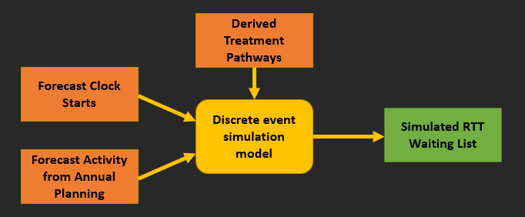
Lots of elements coming together
Forecasting referrals into the Trust using time-series forecasting methods
Treatment pathway analysis to understand what activities our patients need to get their first definitive treatment
Modelling a range of possible futures, depending on treatment pathways, variations in referral demand
Need for a new modelling solution!
Notes:
Began to see how several strands of informative modelling could be combined into a waiting list forecasting model – time series forecasting of ‘front door’ demand (GP referrals etc), analysis and visualisation of patient treatment pathways based on activity recorded on our core systems, and simulation based modelling to see a range of potential waiting list behaviours

Slide 6

Birth of Pythia
Modular tool for Trust activity and waiting list modelling
RTT module – third iteration
User interface created with Shiny
Capacity planning module – currently in active development
Notes:
Pythia is a modular tool – started with RTT modelling, now building a foundation capacity planning module – kind of where we should have started first but never mind! – all built in R with a Shiny front end to allow corporate and operational teams to teams to interact with the model
Third iteration of the methodology since the start of COVID, with the model evolving through each use for annual planning

Slide 7

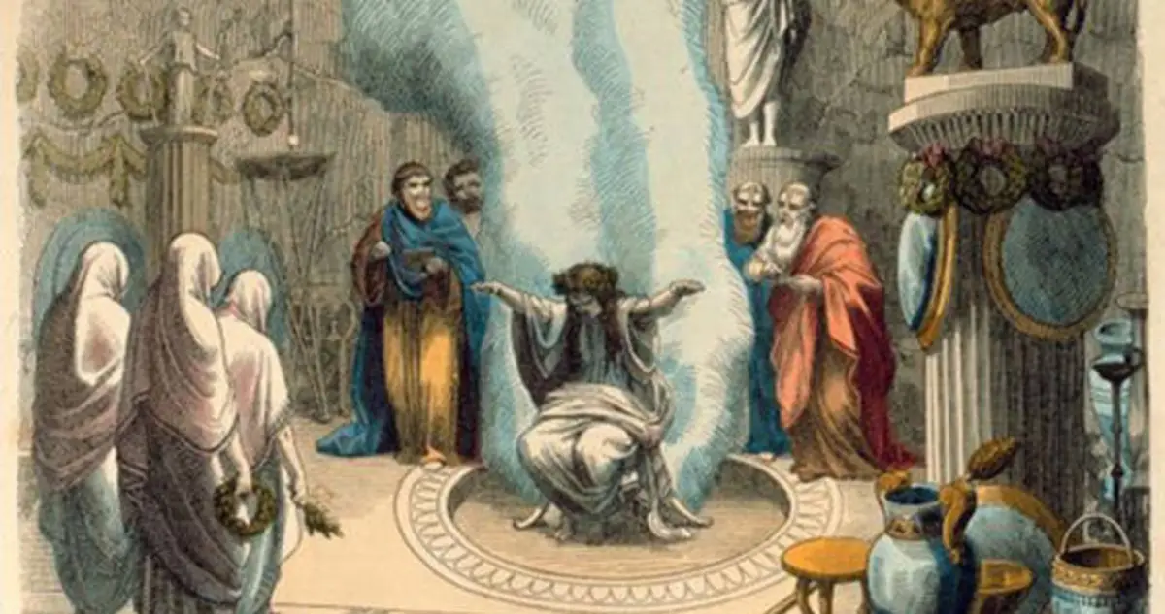
Why “Pythia”?
Pythia (/ˈpɪθiə/;[1] Ancient Greek: Πυθία [pyːˈtʰíaː]) was the name of the high priestess of the Temple of Apollo at Delphi. She specifically served as its oracle and was known as the Oracle of Delphi.
(https://en.wikipedia.org/wiki/Pythia)
Notes:
Try as I might, I couldn’t think of a good acronym that contained RTT, discrete event simulation, waiting list performance modelling
Spend a lot of time feeling like the Information department’s resident prophet or Mystic Meg, so did some googling on famous oracles!

Slide 8
What is Pythia
Stochastic discrete event simulation model, built using the Simmer package
Combines forecasting of clock starts, automated derivation of treatment pathways, and waiting list simulation based on specialty level activity plans
Notes:
Uses DES, in the form of the simmer package
Automated the process of deriving treatment pathways from historic activity data, rather than having to manually construct over 180 individual treatment pathways for cancer/urgent/routine referrals on new or existing patients
Model builds in random (stochastic) variation, whereby patients pass through a series of linked activity nodes with different probabilities

Slide 9
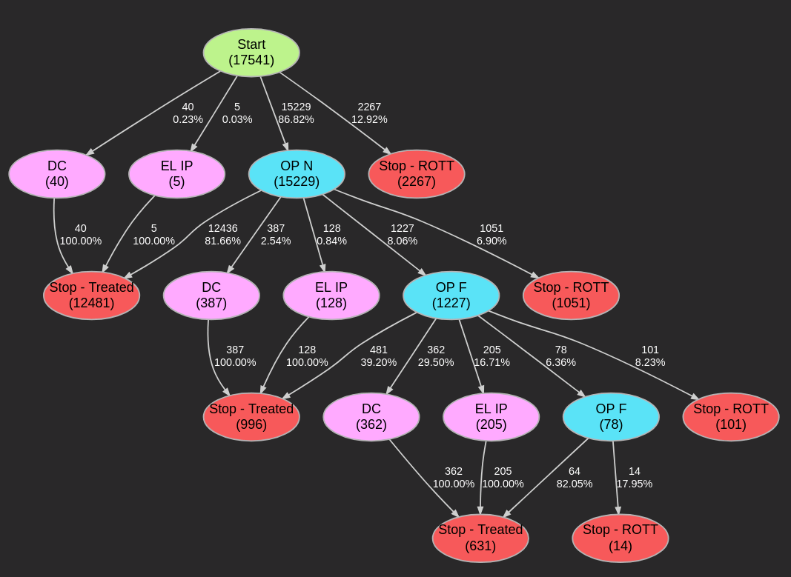
What is Pythia
Stochastic model - ‘dice rolls’ deciding how patients proceed down treatment pathways
Treatment pathways derived from historic RTT activity and parsed into Simmer trajectory instructions
Notes:
Model builds in random variation, whereby patients pass through a series of treatment nodes with probability distributions guiding them on to the next most likely activity or clock stop

Slide 10
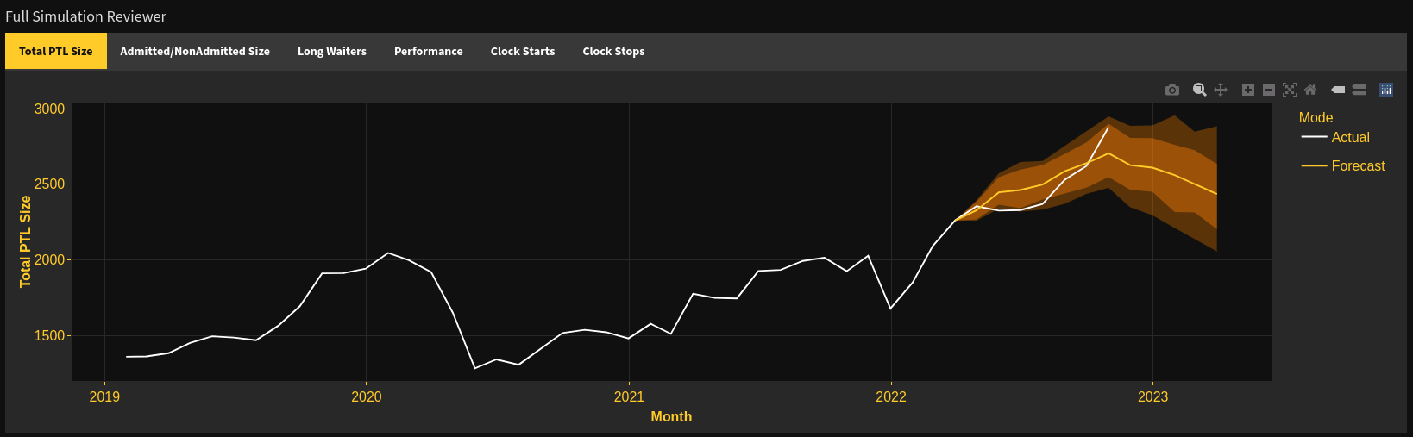
What is Pythia
Custom queueing behaviour
Runs monte-carlo loop – 50 iterations produces ensemble forecasts

Slide 11
What kind of questions have we asked Pythia?
What is the impact on waiting list size of recruiting a new consultant?
What happens to cancer waiting list sizes if more capacity is reallocated to routine long waiters?
How many 18 week breaches could I reduce by lowering DNA rates?
What is the impact of changing treatment pathways to reduce number of follow-up appointments?
What is the impact of changing booking practices across wait bands – creating more capacity to see 78+ week waiters?
Notes:
Real power of Pythia is when you begin to ask what if questions – allows us to quantify the impact of changes to any of the elements which create a forecast – demand, capacity, treatment pathways or change levers within the system like use of capacity, distribution between cancer/urgent/routine etc

Slide 12
How have we used Pythia so far?
Trust annual planning now uses Pythia for RTT
Predicted the level of growth seen in 2021/22 (unfortunately!)
Used by operational managers to quantify the level of risk they face in delivering zero 78+ week waiters
Increasing leadership confidence in medium term waiting list modelling presented to ICS/NHSE
Ability to quantify proposed impact of business cases on RTT performance using a single consistent methodology and readily available tool
Notes:
Pythia is integrated into our RTT modelling – no going back now!
Using this model to predict waiting list growth accurately, especially the Trust’s growth to 60k+ waiting list size, is increasing confidence of execs/Trust leadership in what the model can do
No further need to create ad hoc modelling to support business cases – Pythia should be able to evidence why the extra capacity you want will bring benefits (or not!)

Slide 13

Where to next?
Modular expansion of Pythia into a broader, integrated simulation tool for elective service planning
Modules for cancer, diagnostics, theatres
UI improvements to allow even more questions to be framed in a way Pythia can work with
Peer review!
Notes:
Already mentioned plans for modular expansion of the tool, to encompass all areas of annual planning which the Trust has to undertake each year
Plans for cancer, diagnostic and theatre modules, incorporating insight from each other to improve ‘holistic’ forecasting and see cross-impacts
Make it easier for users to find an easy way to ask their what if question
Peer review from any other trusts undertaking waiting list modelling

